Slide 1
Week 6
Akshat Iyer, Andrew Wu, Eugene Kim, Sebastian Perez, Will Noonan

Slide 2
Problem Statement
We are optimizing reasoning models (LLAMA 3.1) to perform well on standardized test practice (SAT, ACT, etc.)

Slide 3
Optimization Reasoning
Studying for standardized tests is hard when students don’t understand the reasoning behind the correct answer. Therefore, we aim to train a reasoning model to provide the correct answer and reasoning for test questions.

Slide 4
Methodology
The primary approach is Gradient-based Policy Optimization (GRPO), a policy gradient method that improves the model’s reasoning ability via reinforcement learning (RL). Justification for GRPO:
Handles long-horizon reasoning → Unlike supervised fine-tuning, GRPO can optimize multi-step reasoning paths.
Adaptive improvement → Uses reward-based updates to reinforce better reasoning chains.
Avoids overconfidence → Unlike standard transformers, GRPO gradually improves response distribution through sampled trials.

Slide 5
Setup
Download all required libraries from notebook
Tokenize Reasoning-based questions from tests
Unsloth LLAMA-3 Baseline
Fine Tuning with GRPO

Slide 6
Data
Standardized tests with Questions and Answers + Reasoning
SAT + GRE
MMLU
ARC
https://www.kaggle.com/datasets/trainingdatapro/sat-history-questions-and-answers

Slide 7
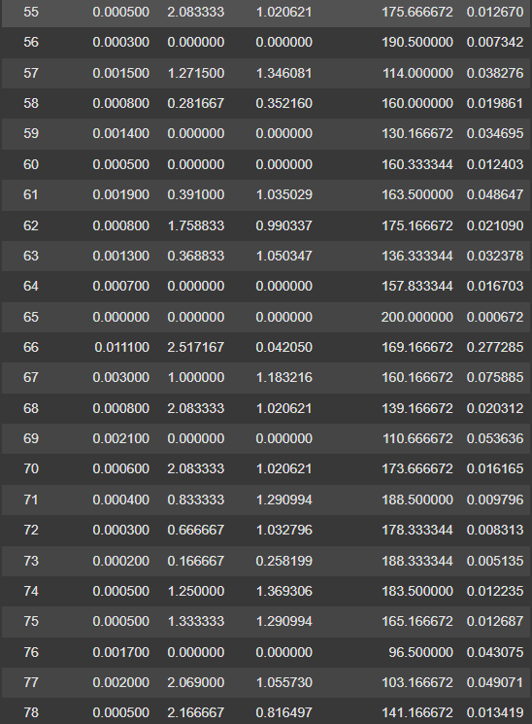
Current Work
We’ve run the preliminary reasoning model on the example colab notebook and observed the output.
We then passed various SAT problems as inputs

Slide 8
Future Work
Train model on Standardized Tests Datasets
Observe reasoning and fine tune answers if needed

Slide 9
Possible Roadblocks
Difficulty in scraping data into readable format by a model
Difficulty in providing conclusive reasoning for answers

